Slide 1
Consumer Information (Annual Notice to Enrolled Students)
Amanda Buchanan, Western Carolina University

Slide 2
DISCLAIMER

Slide 3
Topics
What is Consumer Information?
Who must to receive this information?
Individual One-to-One Basis
Web Posting
Exact URL Information
Paper copies
What must be included?
Other offices
When and how often?
Contact Person(s)
Other Information/Tips
Q&A

Slide 4
What is Consumer Information?
Consumer Information provides institutional information to:
Perspective students
Current students
Parents
Perspective employees
Current employees
The most important aspects of Consumer Information is the Annual Notice to Enrolled Students.
This is distributed annually to all enrolled students, faculty, and staff
Explains Consumer Information and how to obtain it
Distributed on an individual one-on-one basis

Slide 5
Individual One-to-One Notice
Each institution must provide this notice to all enrolled students, faculty and staff on an individual one-to-one basis through appropriate mailings or publications, including:
direct mail using the USPS
campus mail
email

Slide 6
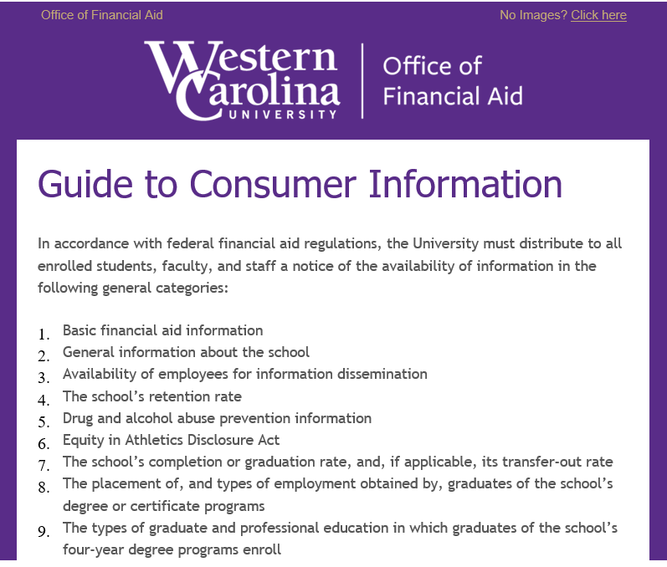
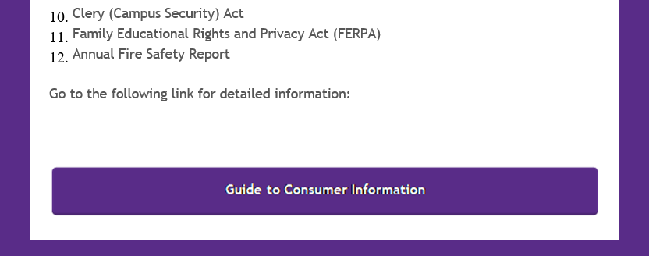
University Email
If email is the dissemination method used, the email must include a direct link to the Annual Notice to Enrolled Students.

Slide 7
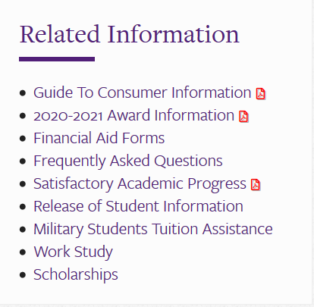
Web Posting
A website posting/listing does not constitute a notice. However, the Consumer Information disclosures outlined in your Annual Notice may be put on your website.

Slide 8
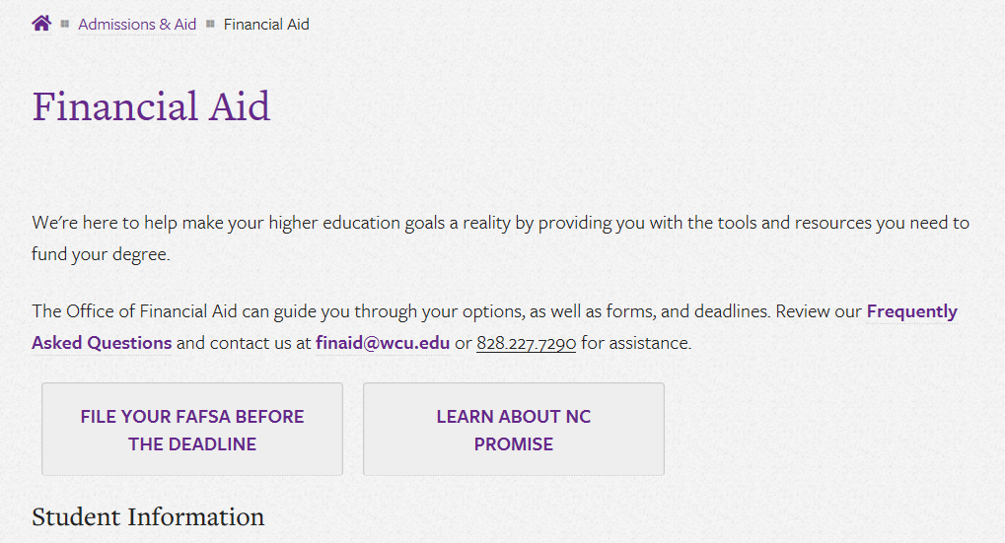
Exact URL Information
The Annual Notice to Enrolled Students must include direct URL links to the information being provided.
https://www.wcu.edu/apply/financial-aid/index.aspx

Slide 9
Paper Copies
Although the information can be shared electronically, by means of email, the institution must notify students, employees, etc. that a paper copy of the disclosures are available.

Slide 10
What Must Be Included?
Financial assistance information
Institutional educational cost information*
Tuition refund policies
Withdrawal procedures and requirements
Return of Title IV funds summary
Accreditation and licensure provisions
Academic program information
Contact information for consumer information assistance
Transfer credit policies
Instructional arrangements with other public institutions, if applicable
*this includes textbook pricing information to the extent possible
Retention, completion, and placement rate disclosures
Gainful employment program disclosures
Drug and alcohol abuse prevention program information
Copyright infringement disclosures
Special services and facilities information
Vaccination policies
Voter registration procedures
Constitution Day and Citizenship Day disclosures
FERPA disclosures
Campus security and fire information
Athletic Information, if applicable

Slide 11
All In This Together
Other offices besides Financial Aid will need to be involved in the construction of your Annual Notice to Enrolled Students. Some examples include:
Campus Police/Security
Registrar
Advising
Dining Services, if applicable
Residential Living, if applicable
Legal
Health Services, if applicable
Bursar/Business Office
Athletics, if applicable

Slide 12
When and How Often?
ED requires the information be shared annually.
Schools can decide when to disseminate information.
Census date!
Keep in mind that some information included in the Annual Notice to Enrolled Students may have other dates that information must be made available.

Slide 13
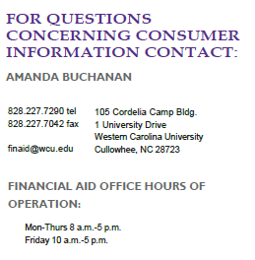
Contact Person(s)
All institutions must have at least one FT employee during normal business hours to discuss Consumer Information*.
If an institution has only one designated employee to assist in obtaining consumer information, that individual must be available, upon reasonable notice, throughout the institution’s normal administrative working hours.
*Waivers can be given for this rule, per ED.

Slide 14
Other Information & Tips

Slide 15
Net Price Calculator & College Financing Plan
Net Price Calculator must be included in the Annual Notice to Enrolled Students/Guide to Consumer Information.
NPC is mean to help students determine how much it would cost to attend the institution for 1 year.
Different types of NPC formats, but ED does not have a standard format requirement for presenting the data to students
College Financing Plan is not required, but highly recommended.

Slide 16
Good Information and Resources
https://ifap.ed.gov/sites/default/files/attachments/2020-01/1920FSAHbkVol2Ch6.pdf
https://ifap.ed.gov/fsa-assessments/05-22-2017-consumer-information
NASFAA AskRegs

Slide 18
Amanda Buchanan, Assistant Director
Western Carolina University
(828) 227-2609
aybuchanan@wcu.edu

Slide 19
Platinum Level Supporters

Slide 20
Gold Level Supporters

