Slide 1
Verification
Dana Kelly
NASFAA
kellyd@nasfaa.org

Slide 2

Verification Data Elements
and Documentation Requirements
Slide 2 © 2025 NASFAA

Slide 3
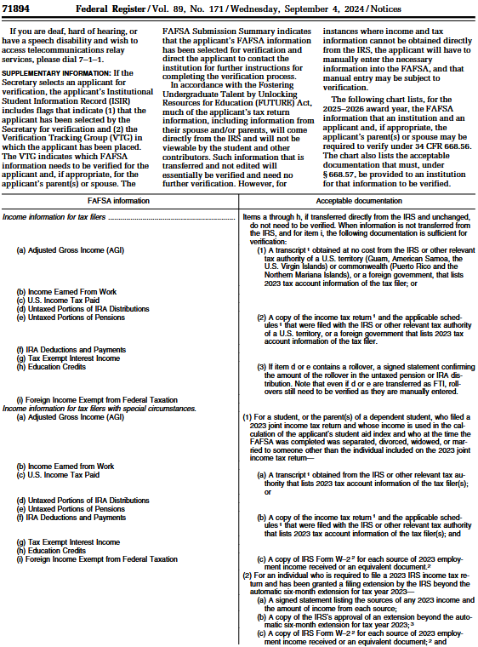
2025-26 Verification Requirements
September 4, 2024, Federal Register, Free Application for Federal Student Aid (FAFSA®) Information to be Verified for the 2025-2026 Award Year
Dear Colleague Letter GEN-24-10, 2025-2026 Award Year: FAFSA® Information to be Verified and Acceptable Documentation (with suggested text)

Slide 4
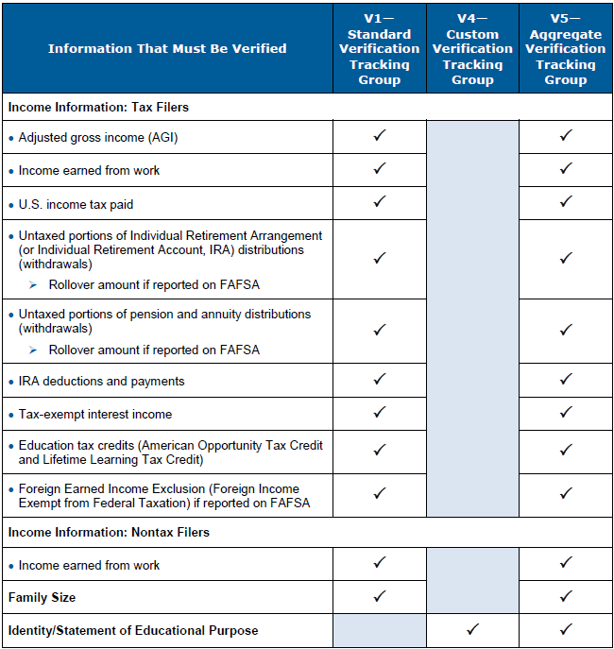
2025-26 Verification Tracking Groups

Slide 5



Acceptable Documentation
Income and Taxes Paid
When verifying AGI, taxes paid, and other forms of income in V1 and V5 for a tax filer, can accept:
Unchanged federal tax information (FTI) obtained via FUTURE Act Direct Data Exchange (FA-DDX);
Tax Return Transcript or other acceptable alternative tax transcript from IRS or relevant tax authority; or
Signed copy of tax return and applicable schedules that were filed with the IRS or tax authority

Slide 6
Verification FTI Transferred Via FA-DDX
FTI via FA-DDX
Number of dependents (family size)
Income earned from work
Adjusted gross income (AGI)
Taxes paid
Untaxed IRA distributions
Untaxed pension and annuity distributions
IRA deductions and payments
Tax-exempt interest
Education tax credits

Slide 7
FA-DDX Versus Manual Entry
FTI from IRS
Unable to Use FTI
FA-DDX
Manual Entry
FAFSA
FAFSA
FTI Module Block on ISIR = Unchanged Verified Data
Manually Entered Data Block on ISIR = Non-FA-DDX Documentation Required

Slide 8
Signed Copies of Tax Returns
For IRS 1040, 1040-SR, and 1040-NR, applicable schedules are only Schedules 1 and 3
No other schedules or forms required for federal verification
For foreign tax returns, applicable schedules are any equivalents to IRS forms (if any)
Anytime Tax Return Transcript is required to complete verification, can accept signed copy of tax return with applicable schedules

Slide 9

Scenario—Copies of Tax Returns
To complete verification, the financial aid office requested a signed copy of Piek Lin’s tax return along with Schedules 1 and 3. The aid office did not receive any of these schedules.
How do you know if any of these schedules were filed or if you should have received any of these schedules from Piek Lin for verification?

Slide 10
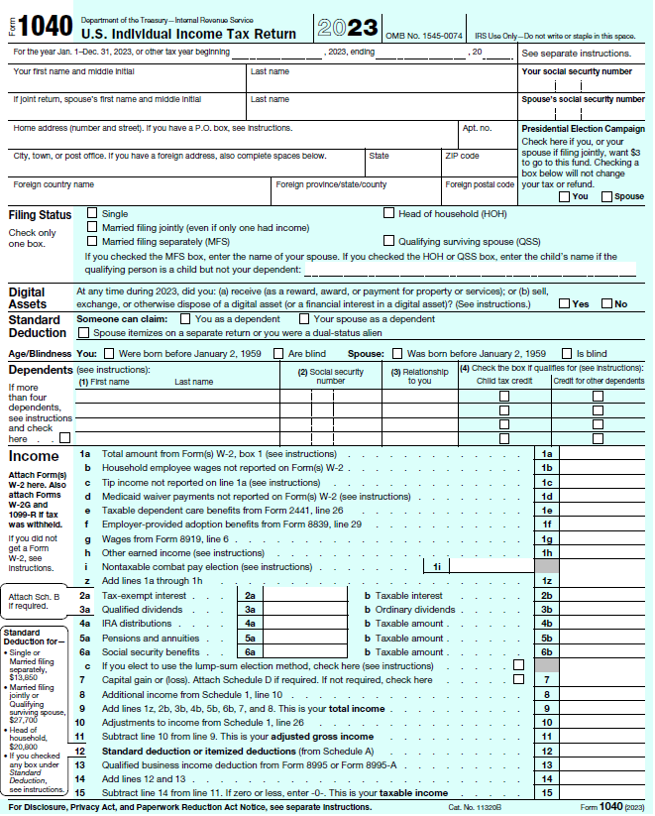
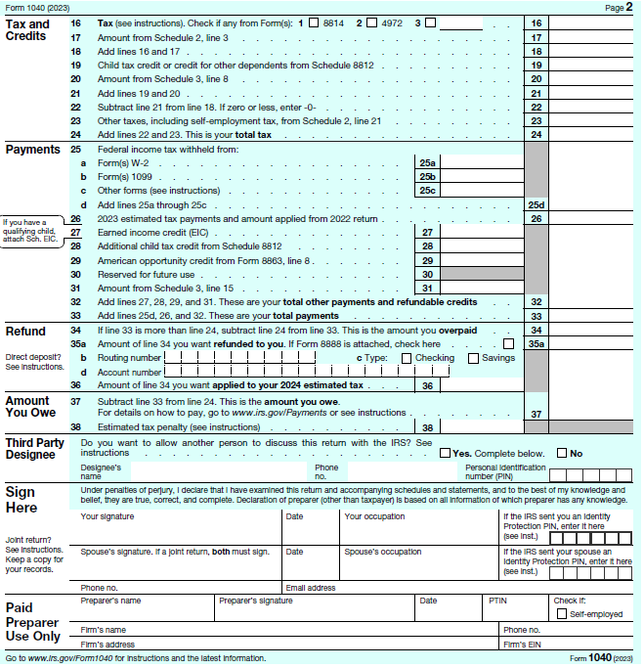
Should I Have Received Schedules?

Slide 11
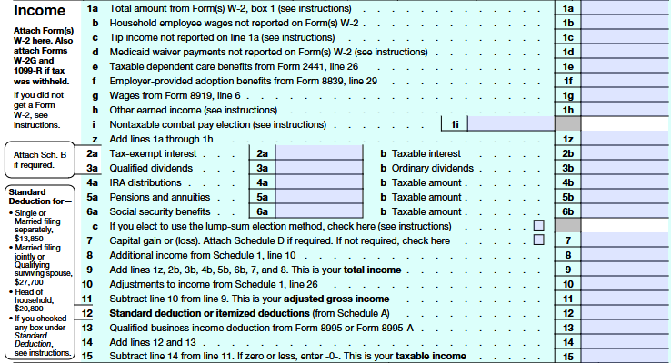
Should I Have Received Schedule 1?
If there is an amount in 1040 Line 8 for additional income from Schedule 1, Line 10 (e.g., business/farm income, Foreign Earned Income Exclusion) that is not blank or zero

Slide 12
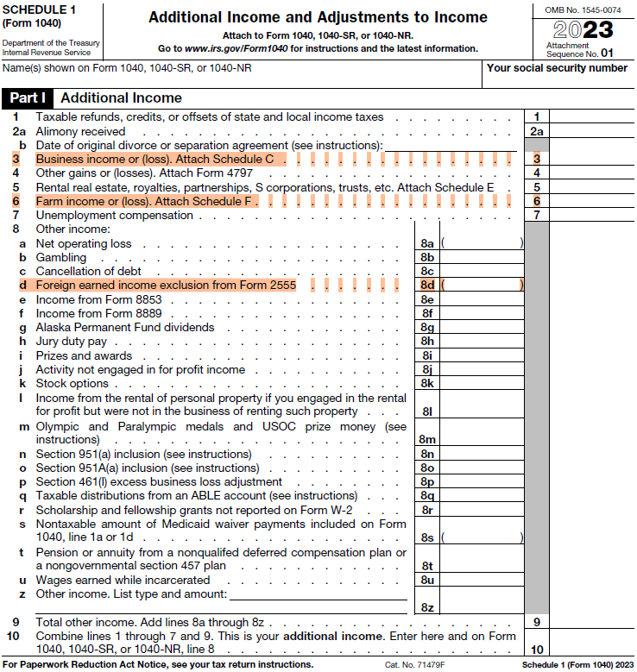
Income earned from work
=
1040 Line 1z + Schedule 1, Line 3 + Line 6
Foreign Earned Income Exclusion
=
Schedule 1, Line 8d

Slide 13
Should I Have Received Schedule 1?
If there is an amount in 1040 Line 10 for adjustments to income from Schedule 1, Line 26 (e.g., IRA deductions) that is not blank or zero

Slide 14
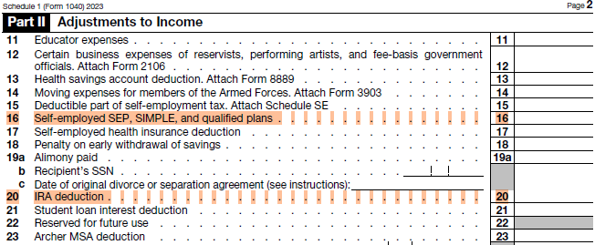
IRA deductions and payments to qualified plans
=
Schedule 1, Lines 16 + 20

Slide 15
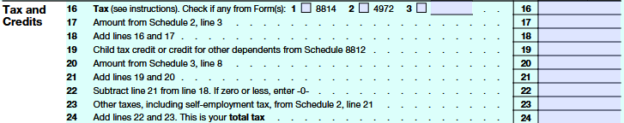
Should I Have Received Schedule 3?
If there is an amount in 1040 Line 20 from Schedule 3, Line 3 (nonrefundable education tax credits) that is not zero

Slide 16
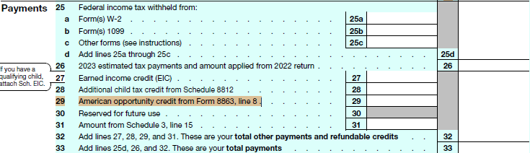
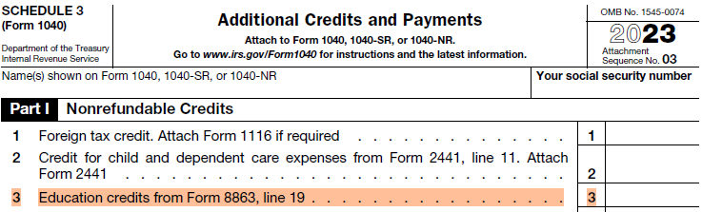
Education tax credits
=
1040 Line 29 + Schedule 3, Line 3

Slide 17
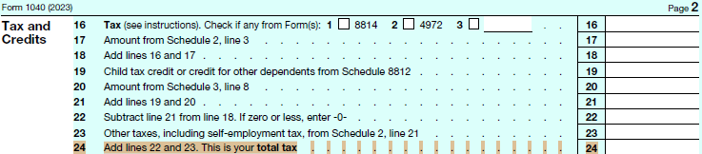
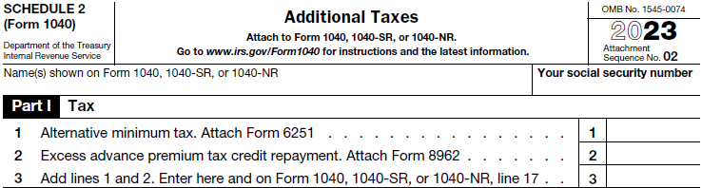

Should I Have Received Schedule 2?
No. Only need 1040 Line 24 for taxes paid

Slide 18
Nonfilers and Income Earned from Work
Slide 18 © 2025 NASFAA

Slide 19

Scenario—Tax Filer and Nonfiler
Charlotte is the parent on the FAFSA, and George is the parent’s spouse on the FAFSA.
  They are both Edward’s parent contributors.
They did not file the tax return as married filing jointly
Charlotte filed an IRS tax return, so her FTI is pulled in using the FA-DDX
George is a nonfiler; he did not and will not file an IRS tax return
Neither had foreign income or worked for an international organization

Slide 20
Pop Quiz
When Charlotte and George complete their respective sections of the FAFSA, does George report his income earned from work?
Slide 20 © 2025 NASFAA

Slide 21
Nonfilers and Income Earned from Work
No
When FAFSA parent (parent 1) is a U.S. tax filer and parent’s spouse (parent 2) is a U.S. nonfiler, and they don’t file a joint tax return, nonfiling spouse is not required to report income earned from work on the FAFSA
Parent’s nonfiling spouse must still complete verification per Federal Register, including W-2s

Slide 22
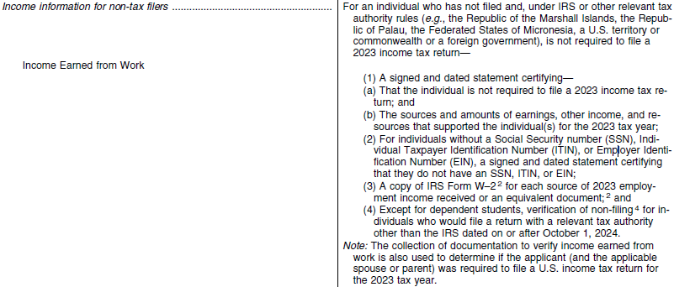
Nonfilers and Income Earned from Work

Slide 23




Earnings, Other Income, and Resources
Gross income in form of money, goods, property, and services
Income included in 1040 Line 1z (wages, tips, etc.)
Income from goods created and sold on online platforms
Income from services provided through mobile apps
Income from, investments, self-employment, or other business activities
Income from part-time or seasonal work
Slide 23 © 2025 NASFAA

Slide 24
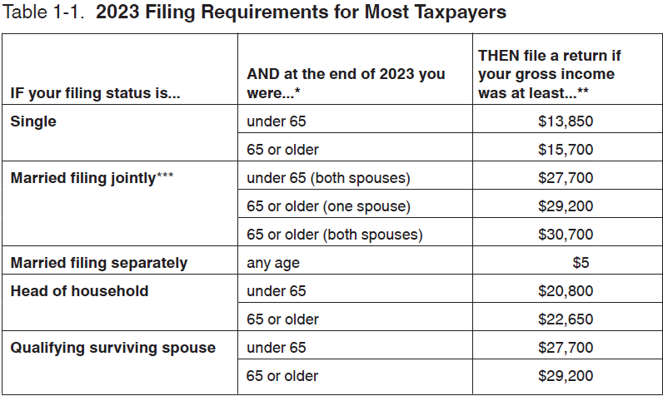
2023 Tax Filing Thresholds
IRS Publication 17

Slide 25
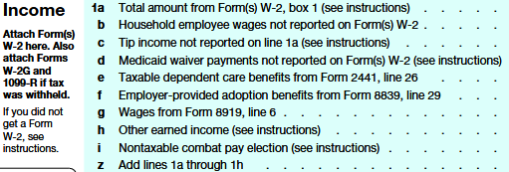
Income Earned from Work (Earned Income)
Income earned from work (earned income) now includes all items that make up 1040 or 1040-NR Line 1z plus business income/loss plus farm income/loss

Slide 26
Foreign Nonfilers and
Income Earned from Work
Foreign nonfilers are not eligible for automatic -1500 student aid index (SAI)
FAFSA contributor must manually answer income, including AGI, income earned from work, untaxed income, taxes paid, etc.
FAFSA instructs to enter income earned from work in AGI and in income earned from work as if tax filers
FAFSA Processing System (FPS) will calculate SAI like U.S. tax filers
Verify by entering income earned from work into AGI and income earned from work fields

Slide 27
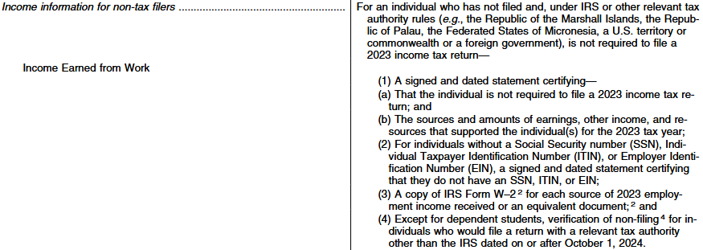
Verification of Nonfiling
Only required if individual would file non-IRS tax return (e.g., foreign country, Puerto Rico, etc.) if they were to file
Required even for zero income

Slide 28
Foreign Earned Income Exclusion
Slide 28 © 2025 NASFAA

Slide 29
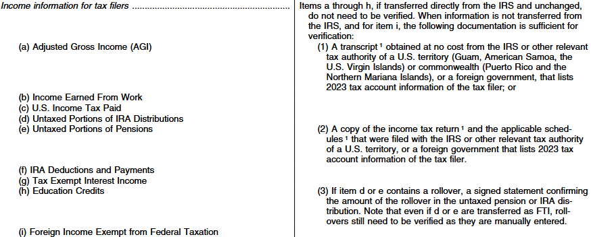
Foreign Earned Income Exclusion

Slide 30
Foreign Earned Income Exclusion
Verify Exclusion only if Exclusion amount is reported on FAFSA
Foreign Earned Income Exclusion is not FTI retrieved via FA-DDX
Verify (i) separately even if (a) through (h) are verified
Per ED, if using copy of tax return, still need 1040 and Schedule 1 even if Exclusion only appears on Schedule 1
Note IRS Form 2555 is not listed as acceptable documentation

Slide 31
IRS Tax-Related Identity Theft
Slide 31 © 2025 NASFAA

Slide 32
IRS Tax-Related Identity Theft
2024-25
2025-26
IRS Tax Return DataBase View (TRDBV) transcript; and
Signed and dated statement from tax filer indicating they are victim of IRS tax-related identity theft and IRS has been made aware of it
Copy of signed 2023 tax return and applicable schedules and:
IRS 4674C letter (letter from IRS acknowledging identity theft), or
Signed and dated statement from tax filer indicating they are victim of IRS tax-related identity theft and IRS has been made aware of it

Slide 33
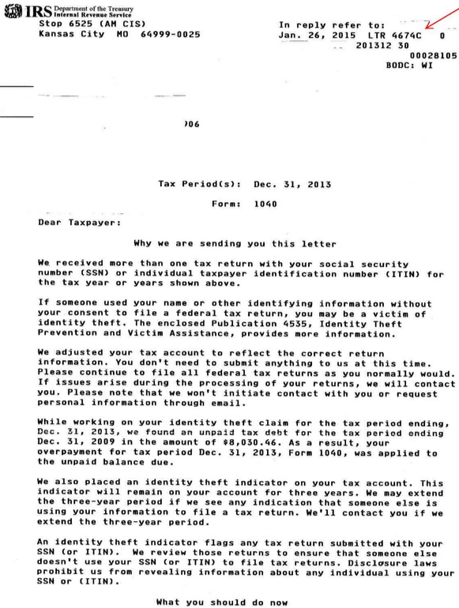
IRS Tax-Related Identity Theft
Tax filer reports to IRS Identity Protection Specialized Unit (IPSU) at 1-800-908-4490
IRS Identity Theft Central website at https://www.irs.gov/identity-theft-central

Slide 34
Amended Tax Returns
Slide 34 © 2025 NASFAA

Slide 35

Scenario—Amended Tax Returns
Kyler filed her 2023 tax return in March 2024
Three weeks later, she discovered an error and filed a 1040-X amended tax return
Kyler filed her 2025-26 FAFSA in January 2025

Slide 36
Pop Quiz
The school needs to collect amended tax return documents (such as a copy of the 1040-X) to complete verification.
  True
  False

Slide 37





Amended Tax Returns
FA-DDX only transfers FTI from original tax return (not amended data)
No indicator or postscreening to alert school of amended tax return or IRS corrections
Only verify if school finds out on ad hoc basis that amended return was filed
Slide 37 © 2025 NASFAA

Slide 38
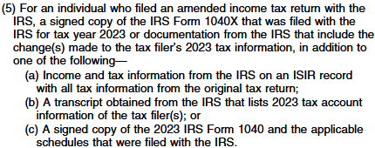
Amended Tax Returns
(a) is FTI from FA-DDX

Slide 39
Amended Tax Returns
School can also accept alternative documentation:
Tax Account Transcript in conjunction with Tax Return Transcript or copy of tax return (without 1040-X); or
Record of Account Transcript by itself (without 1040-X, Tax Return Transcript, or tax return)

Slide 40
Parent of Record and Family Size
Slide 40 © 2025 NASFAA

Slide 41
Parent of Record (Primary Parent)
For dependent students with divorced or separated parents:
  Income and assets are reported for parent who provides most financial support over 12 months immediately prior to filing FAFSA even if student does not live with that parent or lives with other parent;
  If neither parent provided support in 12-month period in #1, parent of record is parent who provided greater support during most recent year student received financial support from a parent; and then
  If equal support is given; parent of record is one with higher income and assets
Parent student lived with most in past 12 months is no longer a criterion

Slide 42
Parent of Record—Not Married to Each Other
Evaluate each individual biological/adoptive parent’s support separately without regard to stepparent’s income or support
Parent providing most support is parent of record
Include parent of record and, if remarried, spouse’s information on FAFSA
Note: If both legal parents are unmarried and living together, both parents are included on the FAFSA.

Slide 43

Scenario—Child Support
The dependent student’s father is paying child support to the student’s mother on the student’s behalf.

Slide 44
Pop Quiz
Which parent includes child support as part of their support for the student?
  Mother
  Father
  It depends

Slide 45
Parent of Record—Child Support
Parent paying child support counts it as part of their support for the student
Father in this scenario counts child support as part of his support for the student
Father is parent of record if child support plus any other support provided by father amounts to more than half of student’s support
  True even if student lives with other parent

Slide 46
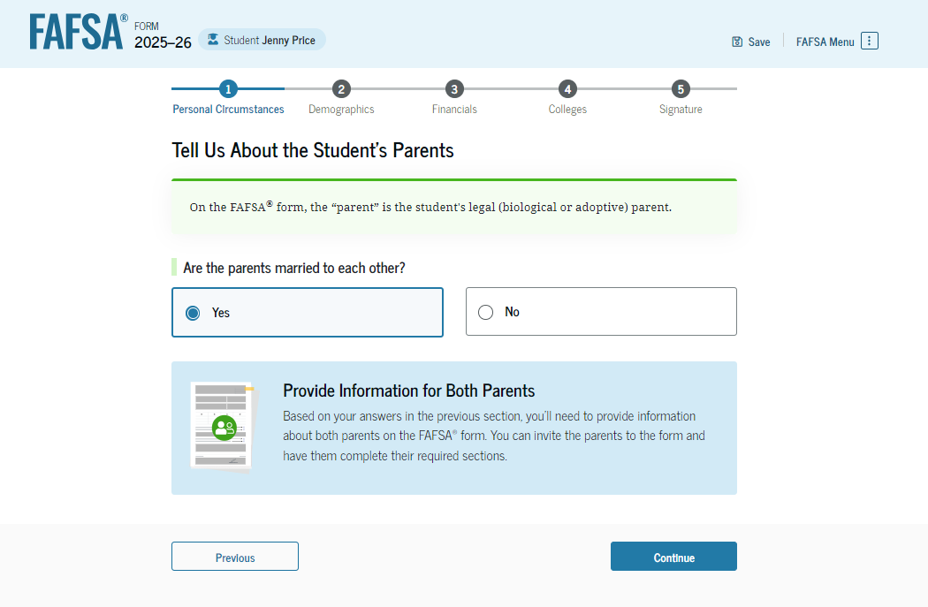
Parent of Record (Primary Parent)
The parent of record is self-reported on the FAFSA, and unless there is conflicting information, there is no requirement for the school to verify or otherwise confirm which parent provides the greater portion of support or if the correct parent is reported on the FAFSA.

Slide 47
Family Size
Family size replaced “household size”
Uses IRS definition of dependents on tax return
See Overview of the Rules for Claiming a Dependent (in handout)
Tax filer(s) plus dependents are included in FTI transferred via FA-DDX
FAFSA contributor (student and/or parent) is given opportunity to manually update family size if it has changed since filing tax return

Slide 48


Family Size—Dependent Student’s Parent(s)
Student
Parent (and their spouse) even if student is not living with them
Parent’s dependent children if they live with parent or live apart due to a period of temporary absence (e.g., college enrollment) and parent provides and will continue to provide, more than half their support between July 1 and June 30 of FAFSA award year
Other people if they live with parent and parent will provide more than half their support between July 1 and June 30 of FAFSA award year

Slide 49
Family Size—Independent Student
Student (and spouse)
Student’s dependent children if they live with student or live apart due to a period of temporary absence (e.g., college enrollment) and student provides and will continue to provide more than half their support between July 1 and June 30 of FAFSA award year
Other people if they live with student and student will provide more than half their support between July 1 and June 30 of FAFSA award year

Slide 50

Family Size—Manually Updated
When manually updating family size, answer FAFSA questions as worded
Not expected to make IRS determinations of dependents unless conflicting information

Slide 51
Family Size—Unborn/Newborn Children
If newborn changes dependency status…
34 CFR 668.55(a)
Dependency status and family size must be updated for entire award year
If newborn does not change dependency status…
34 CFR 668.55(b)
Update only if selected for verification
If neither of the above…
Cannot include unborn/newborn child, not even using professional judgment (PJ)
Must be correct at time of verification

Slide 52
Family Size—Verification
If transferred via FA-DDX and not manually entered…
Family size is unchanged and already verified
If not transferred via FA-DDX or if manually entered…
Statement signed by student (and parent if dependent) listing name and age of each family member, and relationship of that family member to student

Slide 53
Identity and Statement of Educational Purpose
Slide 53 © 2025 NASFAA

Slide 54
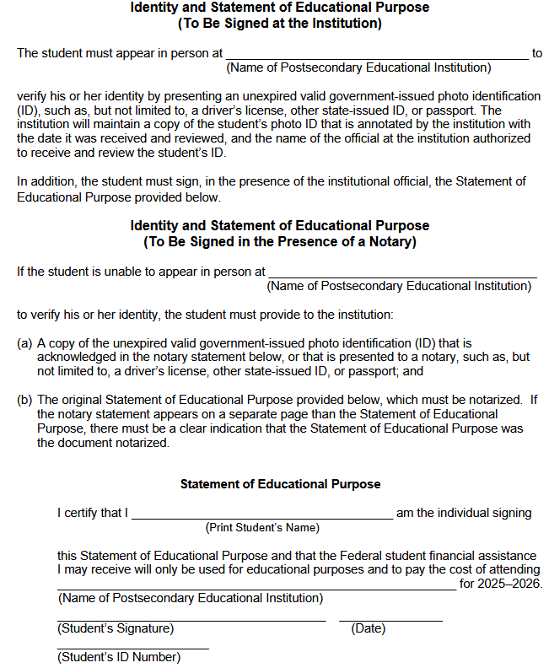
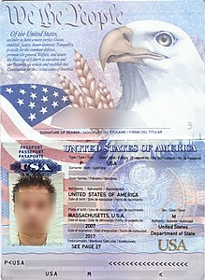
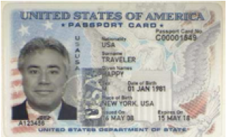
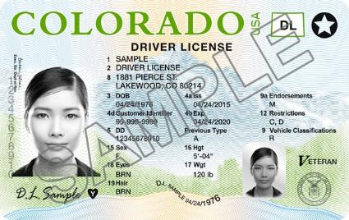
Identity and
Statement of Educational Purpose
Must be presented in person at the same time to school-designated official or to notary public

Slide 55

Identity and
Statement of Educational Purpose
No Online Notaries
No Foreign Notaries
No Zoom, Facetime, etc.
No Electronic Submission

Slide 56


Identity and
Statement of Educational Purpose
When notary public is used, ID and Statement with original “wet” signature must be either:
  Hand delivered to the school, or
  Mailed using U.S. Postal Mail or commercial courier (such as UPS, FedEx, etc.)—that is, they cannot be faxed, emailed, texted, or uploaded to the school
No exceptions

Slide 57
Confined or Incarcerated Students
Slide 57 © 2025 NASFAA

Slide 58
Verification Waiver 2025-26
Student who is confined or incarcerated is only required to verify identity and Statement of Educational Purpose in V4 or V5
Not required to verify student selected for V1
Not required to verify income, taxes paid, or any other items in V5
Student’s spouse or parents not required to complete verification
Conflicting information resolution still required

Slide 59
Student Who Is Confined or Incarcerated
Serving criminal sentence in a federal, state, or local penitentiary, prison, jail, reformatory, work farm, juvenile justice facility, or similar correctional institution
Does not include halfway house or home detention, or is sentenced to serve only weekends
ED compares FAFSA address to Correctional Facility database
ISIR
Incarcerated Applicant Flag
Student files Incarcerated FAFSA—“Incarcerated Applicant Form”
Financial aid administrator sets flag

Slide 60
Confined or Incarcerated Students—
Identity and Statement of Educational Purpose
Exception 1: Can use inmate ID from a government facility, even if it does not have expiration date
Includes privately operated facilities
Only valid if still confined or incarcerated
Exception 2: If unable to submit signed and notarized Statement of Educational Purpose, can accept signed statement from authorized official who works for correctional facility or oversight entity confirming student who completed FAFSA is person signing Statement of Educational Purpose

