Slide 1

Summer and 25-26
State Grants Update
NCASFAA Conference April 2025
Traci Mitchell, CFI, Inc.
*All student information contained throughout this presentation is sanitized; there is no real student information in this presentation.

Slide 2
Summer and 25-26 State Grants Update
Summer State Grants
Summer will be awarded as ONE term on the State Grants Portal
Summer is a trailer
Amount of Summer grant is equal to the calculated amount of the full-time Fall/Spring grant, provided the student has sufficient terms/hours of state grant eligibility

Slide 3
Summer and 25-26 State Grants Update
Summer State Grants
Student must have received a Next NC or NBS grant during 24-25, Fall or Spring, to be awarded a Summer grant. The Fall/Spring grant and Summer grant do not have to be at the same college or sector.
Summer will be prorated the same as Fall and Spring
Student must be at least half-time to receive a Summer grant
The last CFI disbursement for Summer will be July 16, 2025, with last certification date July 15, 2025

Slide 4
Summer and 25-26 State Grants Update
Summer State Grants
Summer state grants will be coded as SUM on the portal and in file downloads. The grant type code will be UNC, CC, NBS
Summer state grants will not be available for the transitional, or smoothing type grants (CC2, UN2)
For private colleges, if your summer term is at a reduced cost, mark the Summer grant as low-cost.

Slide 5
Summer and 25-26 State Grants Update
Summer State Grants
Some FAQs
Q: Must the student have been enrolled in Fall term to get a summer state grant?
A: The student must have received a Next NC or NBS state grant in fall and/OR spring to be eligible for a summer term of state grant.
Q: What if a student attended fall and/or spring, and would have received a state grant except for COA restraints? Would they be eligible for a summer grant?
A: Student must have received a disbursement for a state grant (UNC, CC, NBS) for fall and/or spring to be eligible for a summer state grant.

Slide 6
Summer and 25-26 State Grants Update
Summer State Grants
Some FAQs
Q: Can summer state grants be used for study abroad?
A: Yes, any study abroad program that qualifies for Pell and would qualify for NBS or Next NC for fall or spring also qualifies for summer state grants.
Q: What if a student attended fall and/or spring, and would have received a state grant except for COA restraints? Would they be eligible for a summer grant?
A: Student must have received a disbursement for a state grant (UNC, CC, NBS) for fall and/or spring to be eligible for a summer state grant.

Slide 7
Summer and 25-26 State Grants Update
Summer State Grants
Some FAQs
Q: If a school treats summer as two terms, how do we define full-time for the summer grant? What if a student who would be full time based on summer session 1 plus summer session 2 drops or withdraws from a course before summer session 2 census?
A: If you certify the full-time hours up front, during summer session 1, and the student does not stay enrolled in the expected number of hours, enrolled hours should be adjusted down and funds returned. One way to handle this is not certify any hours until the student reaches at least a half-time status. So, if I student is not enrolled at least half time in session 1, don’t certify until at least half-time status is reached in session 2.

Slide 8
Summer and 25-26 State Grants Update
Summer State Grants
Some FAQs
Q: How should I handle a student enrolled three hours in summer session 1 and 3 hours in summer session 2?
A: There is no need to certify until the student reaches 6 hours. You can certify for three then change to 6 in second session, but no funds will disburse until the student reaches at least half- time status.
A: What is the latest date summer grants can be disbursed?
Q: For 24-25, the final summer disbursement from CFI will be July 16 (rosters) with funds settling in college accounts on July 18. Grants must be certified no later than end of day on July 15 to receive a summer state grant disbursement. Fall and spring state grants will still have an earlier final disbursement date sometime before June 30.

Slide 9
Summer and 25-26 State Grants Update
Summer State Grants
Some FAQs
Q: Students may get a summer state grant at my college even if they received state grants at another college for fall and/or spring. Where can I look to see if a student received a state grant at another college during the regular academic year?
A: 1- CFI will not generate a summer grant for a student that did not have a state grant somewhere during the regular academic year. If the summer grant is funded and eligible, no need to check on fall and/or spring for that student.
2- To view this information prior to summer grants appearing on the portal, go to Maintenance, Student. Pull up the student’s record and click on the Tracking tab.

Slide 10
Summer and 25-26 State Grants Update
Summer State Grants
Some FAQs
Q: NBS only: Our students are “low-cost” for summer term. Will coding them low-cost for summer affect their other terms of state grant at regular cost?
A: No, the low-cost award amount is term specific and will not affect other terms for the student.
Q: NBS: Does the yearly maximum award of $15,000 for NBS include summer?
A: No, a student may exceed $15,000 with the addition of a summer award.

Slide 11
Summer and 25-26 State Grants Update
Summer State Grants
Some FAQs
Q: How will being over 500 Pell LEU affect a student’s summer grant amount?
A: The summer grant amount will be the same amount as fall/spring, provided the student has adequate terms/hours remaining. This is true regardless of when the student exceeded 500 LEU.

Slide 12
Summer and 25-26 State Grants Update
Summer State Grants
Questions and Discussion

Slide 13
Summer and 25-26 State Grants Update
State Grants: 2025-2026
Next NC CC and Next NC UNC remain a formula- no changes except for students with Pell LEU > 500
NBS:
  Formula starting 2025-26
  Proration by hour, like Pell, starting 2025-26

Slide 14
Summer and 25-26 State Grants Update
State Grants: 2025-2026
Next NC CC and UNC
AGI Limit: $80,000
SAI Limit: 7,500
Guarantee: $3,000 for CC, $5,000 for UNC

Slide 15
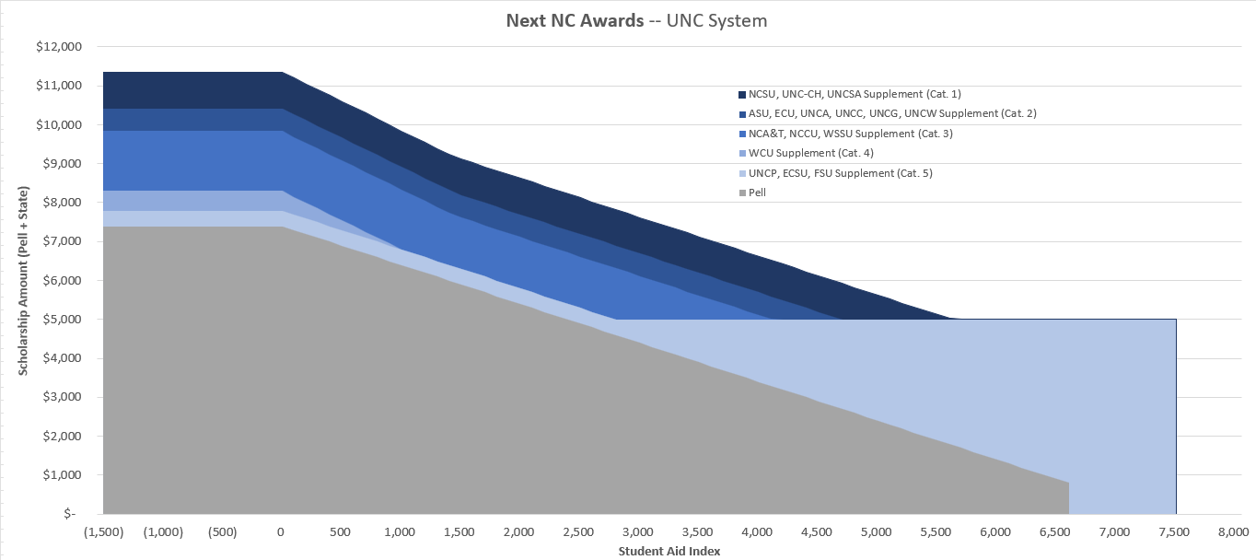
Summer and 25-26 State Grants Update
State Grants: 2025-2026
Next NC UNC Award Calculation
Guarantee + Supplement – Pell
If Pell LEU>500, Guarantee – Pell Minimum Annual Award: $400

Slide 16
Summer and 25-26 State Grants Update
State Grants: 2025-2026
Next NC CC Award Calculation
SAI -1,500-0: $200 SAI 400-2,795: $400
SAI 1-399: $300 SAI 2,796-7,500: Guarantee + Supplement - Pell
If Pell LEU > 500: Guarantee-Pell Minimum Annual Award: $200

Slide 17
Summer and 25-26 State Grants Update
State Grants: 2025-2026
NBS
AGI Limit: $160,000
SAI Limit: 15,000
Base Amount: $5,000
Max NBS+Pell: $15,000
Max Supplement: $10,000

Slide 18
Summer and 25-26 State Grants Update
State Grants: 2025-2026
NBS Award Calculation
Regular:
SAI -1,500 – 1,000: $15,000 – Pell
SAI 1,001 – 12,500: Base Amount + Calculated Supplement – Pell
SAI 12,501 – 15,000: $5,000 - Pell
Pell LEU > 500: Base Amount – Pell
Supplement Calculation:
Max Supplement- (Max Supplement*(SAI-1,001)/11,499)) - Pell

Slide 19
Summer and 25-26 State Grants Update
State Grants: 2025-2026
NBS Award Calculation
For Low-Cost Programs
Full time award for all SAI’s= $2,200 annually
For Pell LEU > 500: $2,200 - Pell

Slide 20
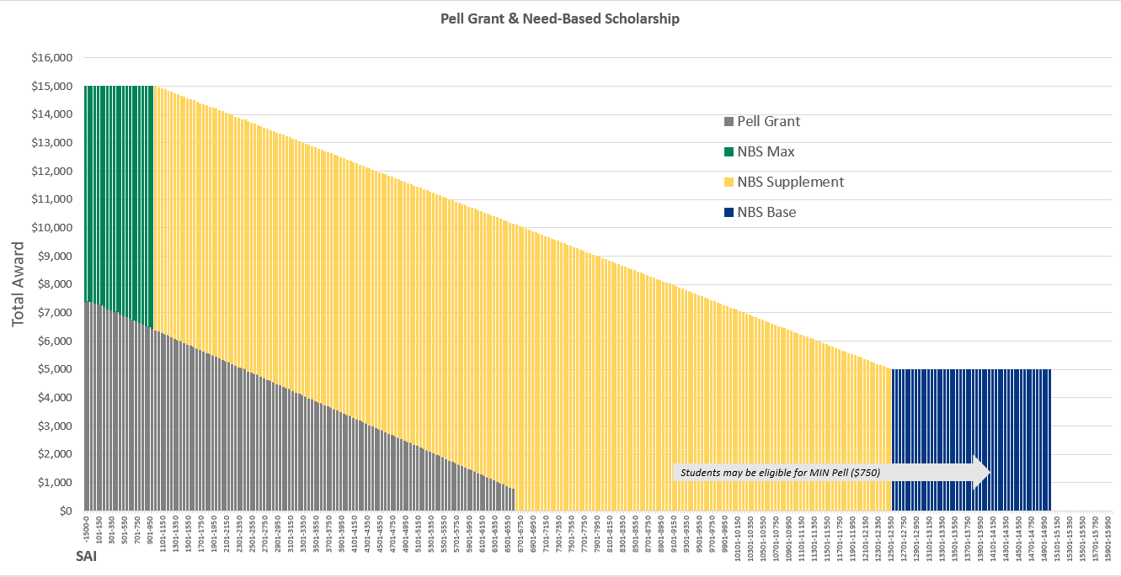
Summer and 25-26 State Grants Update
State Grants: 2025-2026
NBS Award Calculation- Visual Representation

Slide 21
Summer and 25-26 State Grants Update
State Grants: 2025-2026
NBS
Beginning 2025-2026
Proration by enrolled hours, like Pell
Last hour utilization: no longer need at least 6 hours of eligibility remaining to receive NBS.

Slide 22
Summer and 25-26 State Grants Update
State Grants: 2025-2026
Pell LEU > 500
CFI has access only to the Pell LEU on the ISIR, which may be inaccurate/out of date
Pell amount is part of the formula for NBS and Next NC, so calculating Pell correctly is imperative to students receiving the Guarantee(Next NC) or Base (NBS) Amount
CFI will rely on colleges to provide an updated Pell LEU for students with LEU > 500 at the start of the academic year

Slide 23
Summer and 25-26 State Grants Update
State Grants: 2025-2026
Pell LEU > 500
To start, CFI will calculate the state grant for students with Pell LEU > 500 using the LEU reported on the ISIR.
2025-2026 grants are currently using LEU reported on the ISIR.
When the college uploads a new LEU, or provides a new LEU via entry on the portal, CFI will recalculate the student’s state grant.

Slide 24
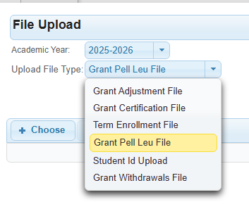
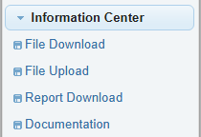
Summer and 25-26 State Grants Update
State Grants: 2025-2026
Pell LEU > 500 – File Upload
Timing is crucial: Uploaded Pell LEU must reflect all Pell received to date, prior to Fall.

Slide 25
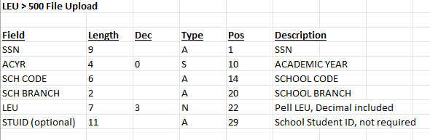
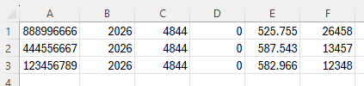
Summer and 25-26 State Grants Update
State Grants: 2025-2026
Pell LEU > 500 – File Upload
File layout Example file, school code 004844-00

Slide 26
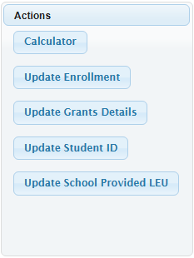
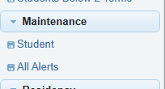
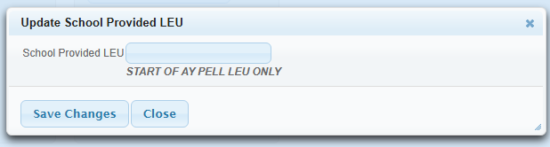
Summer and 25-26 State Grants Update
State Grants: 2025-2026
Pell LEU > 500 – Manual update per student

Slide 27
Summer and 25-26 State Grants Update
Questions?????
Traci Mitchell traci.mitchell@cfi.org 919-835-2364

