Slide 1
State Update
North Carolina State Education Assistance Authority
October 29, 2020
Elizabeth McDuffie

Slide 2
Topics
Legislation
FAFSA Trends and State Programs 2020-21
Outreach

Slide 3
Legislation
CARES Act Funding
  NC COVID-19 Relief Funds
  Governors Emergency Education Fund
Education Lottery Scholarship

Slide 4
COVID-19 Relief Funds
Federal CARES Act provided funds for distribution by:
NC General Assembly
  House Bill 1043 (S. L. 2020-4)
  House Bill 1105 (S. L. 2020-97)
Governor’s Office
  Governor’s Emergency Education Relief Funds
  $95.6m total
  SEAA to administer portion for private nonprofit institutions

Slide 5
Session Law
2020-04: Federal Coronavirus Relief Funds
The Authority to allocate funds to private nonprofit postsecondary institutions*:
  To be used to transition to online education for students
  To provide funds for students and families impacted by COVID-19
*Institutions defined in statute as eligible to participate in the NC Need-Based Scholarships
UNC and the NC Community Colleges received funding directly through their system offices.

Slide 6
Session Law
2020-97: Federal Coronavirus Relief Funds
The Authority to provide financial assistance for:
  Students enrolled in eligible private nonprofit postsecondary institutions affected by COVID-19
The Authority to provide funds to institutions for Personal Protective Equipment (PPE):
  Private nonprofit postsecondary institutions who participate in the NC Need-Based Scholarship
Legislation signed 9/4/2020 and funds to be expended by 12/30/2020

Slide 7
Education Lottery Scholarship
Updated EFC eligibility criteria
Original EFC maximum was 5000; raised to 6000
    Current maximum is 5711;
Updated maximum grant when combined with Pell from $4,000 to $5,100
    Current year maximum is $4,227

Slide 8
Education Lottery Scholarship
Education Lottery Scholarship eligibility parameters adjusted for inflation—finally!
First adjustment since inception in 2007

Slide 9
FAFSA Application Trends and State Program Reports

Slide 10
Number of NC FAFSAs
Ref: https://studentaid.gov/data-center/student/application-volume/fafsa-school-state

Slide 11
FAFSA Volume—October 15

Slide 12
State Grants 2000–01 through 2020–21

Slide 13
State Grant Status for 2019-20
The following programs continue to fund new applicants as FAFSAs are submitted:
  NC Community College Grant
  NC Education Lottery Scholarship
  NC Need-based Scholarship
  UNC Need-based Grants
Certification goal for fall awards – December 4

Slide 14
NC Assist Loans
State Loan Program for Parents and Students
SEAA Board of Directors authorized increased funding for the program in 2020
  Lowered fixed interest rates to:
    5.25% for parents
    5.5% for students
      Additional .25% reduction for auto draft
  Minimum credit score of 700
  Annual maximum available up to COA
The loan program continues to grow!

Slide 15
Outreach and Training

Slide 16
College Access Initiatives
Focus on increasing number of high school seniors completing the FAFSA (Free Application for Federal Student Aid) continues
MyFutureNC www.myfuturenc.org
  Enlisted support from school superintendents and DPI
  Providing support to Countdown to College
  Creating FAFSA tracker/dashboard to provide data on FAFSA completion by high school/district.

Slide 17
College Access Initiatives
Held FAFSA completion events throughout the year with assistance from NCASFAA and the State Employees Credit Union.
Collaborated with MyFutureNC, which held a FAFSA Frenzy in June 2020. SEAA coordinated financial aid expertise offered at 11 online FAFSA completion events in June, in addition to providing content support, via CFNC, for FAFSA Frenzy online resources.

Slide 18
College Access Initiatives
Finish the FAFSA Program tracks the FAFSA completion status for all high school seniors in participating NC public high schools.
  School counselors use the database to identify students who may need assistance completing the FAFSA.
  In the 2019-20 academic year, participation increased to include 99% of all North Carolina public high schools.
High school seniors in North Carolina public high schools completed 63,489 FAFSAs as of July 31, 2020. This represents 60% of the public high school class of 2020.
North Carolina ranked 18th in the nation for FAFSA completion in 19-20

Slide 19
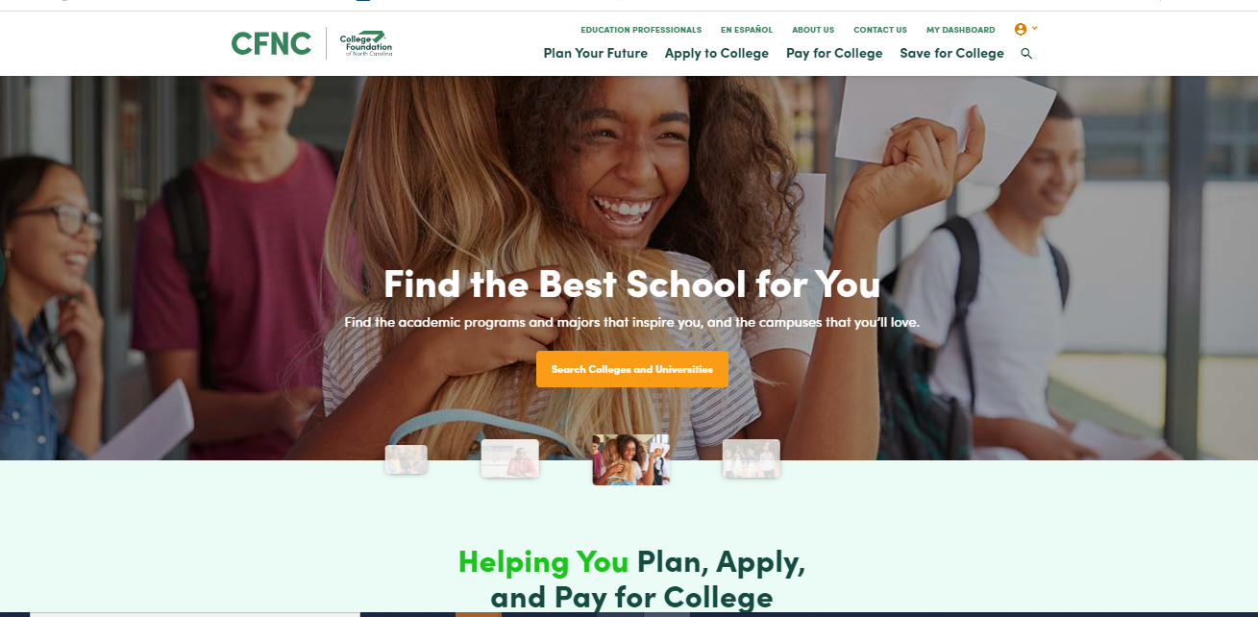
New CFNC Website!

Slide 20
CFNC: Twenty Years of Service!
New website launched this fall with a slimmed down look and easier navigation for users
Explore NC colleges and careers
Apply to colleges and search for scholarships or other aid
Soon, CFNC and NCCareers will share a single sign on so users can learn more about careers and the related education paths and save their information in a single account

Slide 21
Countdown to College 2020
Finishing up tomorrow (10/30) at 5:00 p.m
Two-week application period rather than traditional one week
Virtual sessions with admissions and financial aid experts to help answer questions
  THANK YOU to those of you who offered your time to join these sessions!

Slide 22
Coaches Pitching to
Students!
https://www.youtube.com/watch?v=Ym2sjxbrbxY

Slide 23
Staff Changes at SEAA
Retired staff: Gwen Canady and Marcia Weston
Retirements imminent: Kimberly Rempson
    (RDS Program Manager)
Executive Director Search Process Update

Slide 24
Questions/Comments

