Slide 1
NCASFAA FALL Conference

Slide 2
Today’s Topics
COVID-19
Eligibility When Grade Level or Enrollment Status Changes
Origination and Disbursement
Loan Proration
Annual Student Loan Acknowledgement
Federal Direct PLUS Loan Program
Miscellaneous
Slide 2 © 2020 NASFAA

Slide 3
COVID-19
Slide 3 © 2020 NASFAA

Slide 4
COVID-19 and Interest Accrual
Will payments and interest be suspended on parent PLUS Loans due to COVID-19?
0% interest rate applies to loans held by ED
Defaulted and nondefaulted Direct Loans
Defaulted and nondefaulted FFEL Program Loans
Defaulted and nondefaulted Federal Perkins Loans
Defaulted HEAL Loans
December 31, 2020 or the end of the national emergency
Slide 4 © 2020 NASFAA

Slide 5
COVID-19 and PSLF
Will suspended payments count toward Public Service Loan Forgiveness (PSLF)?
Yes, if you work full-time for a qualifying employer during the suspension
Slide 5 © 2020 NASFAA

Slide 6
COVID-19 and Loan Rehabilitation
Will loan payments that are suspended due to coronavirus count toward loan rehabilitation?
Yes
Suspended payments count as if actual payment was made
Does not count toward satisfactory repayment arrangements to clear a defaulted loan
Slide 6 © 2020 NASFAA

Slide 7
COVID-19 and Loan Repayment
For borrowers who enter their grace period during the suspension period, will their grace period be extended?
No, grace period would begin as normal
Unless loans were scheduled to enter repayment prior to December 31, suspension period would not apply
Slide 7 © 2020 NASFAA

Slide 8
Coronavirus Indicator
What is deadline for schools to mark the coronavirus indicator in COD?
12/31/2020 September 23, 2020 Electronic Announcement
If deadline is further extended, NASFAA will update the AskRegs Knowledgebase
Slide 8 © 2020 NASFAA

Slide 9
Coronavirus Indicator and R2T4
The R2T4 tool coronavirus indicator has a different function than the general COD coronavirus indicator, correct?
Yes
If a school uses ED’s R2T4 tool, it will need to check off both the R2T4 coronavirus indicator AND the COD coronavirus indicator, as applicable. There is no linkage between tools.
Deadline is 09/30/21.

Slide 10
Eligibility When Grade Level or Enrollment Status Changes
Slide 10 © 2020 NASFAA

Slide 11
Enrollment Status Changes
Scenario
Crystal is second-year undergraduate
Registered for 14 credit hours prior to fall term
School disburses 10 days prior to start of payment period
Disbursed Direct Loan on August 18
On August 20, Crystal dropped classes and is only now scheduled to attend 4 credit hours
Do we have to return the loan funds since she is now enrolled less than half time?
Slide 11 © 2020 NASFAA

Slide 12
Enrollment Status Changes
Do we have to return the loan funds since she is now enrolled less than half time?
No
There is no regulatory requirement for schools to recalculate Direct Loan eligibility for enrollment status changes, unless the student does not begin attendance in any classes for a term/payment period within the loan period
As long as the school verifies that the student was enrolled at least half time at the time of disbursement, she remains eligible for the funds even if she subsequently drops below half time
Slide 12 © 2020 NASFAA

Slide 13
Enrollment Status Changes
The same rules apply for payment periods with modules
As long as at the time of disbursement the student was registered at least half time in any combination of modules within the period, the student keeps the loan funds even if she does not attend a later module in the period
16-week term
8-week module 1—Enrolled for 4 credit hours
8-week module 2—Enrolled for 4 credit hours
Disbursement for entire period
Drops module 2, but keeps loan funds
Slide 13 © 2020 NASFAA

Slide 14
Academic Program Changes
Scenario
26-year old student attended another university during the fall semester, pursuing a graduate degree
Borrowed $10,250 in Direct Unsubsidized Loan funds
He transferred to our school for the spring semester, pursuing a second bachelor’s degree during the same academic year
Classified as a 5th year student at our school
How do we determine the maximum he may borrow for the rest of the academic year?
Slide 14 © 2020 NASFAA

Slide 15
Academic Program Changes
How do we determine the maximum he may borrow for the rest of the academic year?
He may borrow $10,250
The undergraduate annual loan limit applies, and amounts borrowed at the graduate level for the fall do not count against the undergraduate loan limit
However, the total amount awarded for the academic year may not exceed the higher annual loan limit
Slide 15 © 2020 NASFAA

Slide 16
Loan Origination and Disbursement
Slide 16 © 2020 NASFAA

Slide 17
Loan Origination
Scenario
School realized it failed to originate a loan for a student before a loan period ended
Student submitted email request to accept loan funds but email was stuck in spam filter at school
Can the loan be originated now that the loan period has ended since it was not the student’s fault?
Slide 17 © 2020 NASFAA

Slide 18
Loan Origination
No. Loans may not be originated after the end of a loan period.
Late disbursement rules apply
The loan must be originated prior to the student ceasing half-time enrollment
It does not matter why the loan was not originated
Slide 18 © 2020 NASFAA

Slide 19
Loan Origination
Scenario
Kyler is a 20-year old, second-year undergraduate
Transferred at the beginning of summer term
Attended another school during the fall and spring, but did not borrow Direct Loan funds
Summer term cost of attendance = $12,000
Kyler is only eligible for Direct Loans
Can we award the entire annual loan limit during the summer term if she will be enrolled at least half time?
Slide 19 © 2020 NASFAA

Slide 20
Loan Origination
Yes. If Kyler is eligible for the full annual loan limit, you cannot limit the amount she borrows.
Loan period must reflect the single term
May require two disbursements
COA
EFC
EFA
Max Sub
COA
EFA
Max Unsub
Slide 20 © 2020 NASFAA

Slide 21
Loan Origination
Scenario:
Marcus is planning to attend class on campus in the fall and then take advantage of a study-abroad opportunity for the spring term
The costs associated with the two terms are going to be very different
We were told we must originate loans with equal disbursements
How can we accurately originate a loan for Marcus?
Slide 21 © 2020 NASFAA

Slide 22
Loan Origination
You may use two separate loans; one for fall and one for spring.
COA, EFC, and EFA based on single term
May require two disbursements of each loan
OR
You may use two separate loans; one for fall/spring and one for the difference in cost for the spring.
COA, EFC, and EFA based on loan period
May require two disbursements of spring-only loan
Slide 22 © 2020 NASFAA

Slide 23
Loan Proration
Slide 23 © 2019 NASFAA

Slide 24
Loan Proration
Scenario:
When an undergraduate student only needs to attend one more term to finish their program, we have been offering the student one-half of their annual loan limit
An auditor recently told us that we have been doing this incorrectly
How should we be calculating the student’s Direct Loan eligibility?
Slide 24 © 2020 NASFAA

Slide 25
Loan Proration
The student’s eligibility must be determined based on the number of hours needed to complete the program.
Compare the number of hours the student will be enrolled with the number of hours in the academic year
Determine maximum subsidized and unsubsidized loan eligibility
Slide 25 © 2020 NASFAA

Slide 26
Loan Proration
8 hours
24 hours
1/3 or 0.33
Calculate maximum base eligibility:
0.33
$5,500
$1,833
Slide 26 © 2020 NASFAA

Slide 27
Loan Proration
Calculate maximum additional unsubsidized eligibility:
0.33
$2,000
$660
Maximum base eligibility $1,833
Maximum add’l unsubsidized eligibility $660
Slide 27 © 2020 NASFAA

Slide 28
Loan Proration
Scenario:
Laney will complete her undergraduate degree in December and plans to begin graduate work in January
Do we have to prorate her undergraduate loan when she’s starting a graduate program in the same academic year?
Slide 28 © 2020 NASFAA

Slide 29
Loan Proration
Yes, because proration is required when an undergraduate student’s final period of study is less than one academic year in length.
School may process the spring loan using the graduate level COA and EFC
Spring loan based on graduate annual loan limits
Loan proration never required for graduate students
Slide 29 © 2020 NASFAA

Slide 30
Loan Proration
Scenario
Darius was scheduled to graduate in December
School prorated his loan eligibility
After disbursement we discovered that he has two additional classes (8 credit hours) needed to graduate
Will not be graduating until the end of the spring term
What do we do when a student’s end date changes after loans have been prorated?
Slide 30 © 2020 NASFAA

Slide 31
Loan Proration
Offer the remaining annual loan limit for the spring term.
Student may now receive full annual loan limit
* If loan had not yet disbursed, school could re-package student without prorating loans and originate loan with adjusted loan period.
Slide 31 © 2020 NASFAA

Slide 32
Loan Proration
Scenario:
Tyler is a 5th-year student who has borrowed $29,000 of his aggregate loan limit, with $22,000 in subsidized loans
Tyler was scheduled to graduate in the spring, but realized he will need to return in the fall term to complete 8 credits
I know we need to prorate his loans, but how does the aggregate limit affect his eligibility?
Slide 32 © 2020 NASFAA

Slide 33
Loan Proration
*Proration determines maximum eligibility. In some cases, student is not eligible for the maximum amount.
Calculate maximum base eligibility:
8 hours
24 hours
1/3 or 0.33
0.33
$5,500
$1,833
Slide 33 © 2020 NASFAA

Slide 34
Loan Proration
0.33
$2,000
$660
Calculate maximum unsubsidized eligibility:
$1,833 + $660 = $2,493 Total Prorated Eligibility
Maximum subsidized eligibility $1,000
Maximum unsubsidized eligibility $1,000
Student reaches aggregate and has no further eligibility
Slide 34 © 2020 NASFAA

Slide 35
Loan Proration
Scenario
Olivia needs 8 credits to complete program
Courses are only offered in the spring term
Olivia will not attend fall term and will return for spring
Do we have to prorate loans for the spring term in this instance?
Slide 35 © 2020 NASFAA

Slide 36
Loan Proration
Yes. Her period of enrollment is shorter than an academic year.
8 hours
24 hours
1/3 or 0.33
0.33
$5,500
$1,833
Maximum base eligibility
0.33
$2,000
$660
Maximum add’l unsub eligibility
Slide 36 © 2020 NASFAA

Slide 37
Annual Student Loan Acknowledgement
Slide 37 © 2020 NASFAA

Slide 38
Annual Student Loan Acknowledgement
What do we need to know about the new Annual Student Loan Acknowledgement?
March 27,2020 Electronic Announcement
ASLA requirement delayed until 2021-22
Requirement applies to all Direct Loan borrowers—including parent PLUS Loan borrowers
Must be completed annually, prior to disbursement of loan
Slide 38 © 2020 NASFAA

Slide 39
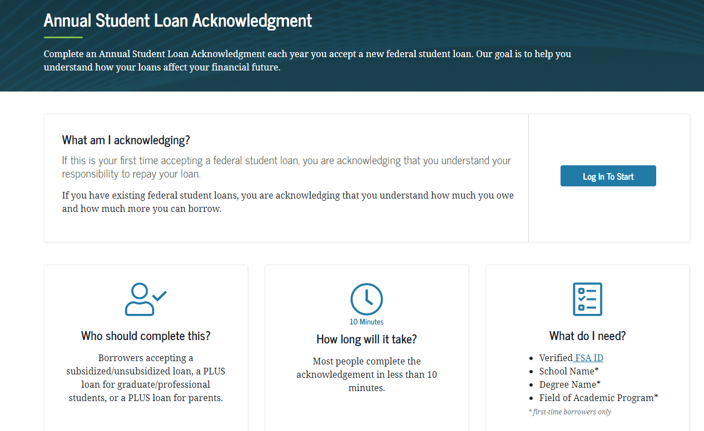
Annual Student Loan Acknowledgement
studentaid.gov
Slide 39 © 2020 NASFAA

Slide 40
Direct PLUS Loan Program
Slide 40 © 2020 NASFAA

Slide 41
Parent PLUS Loan
Scenario:
Gerald’s mother was denied a parent PLUS Loan and he received additional Direct Unsubsidized Loan funds
We just received an approved application from Gerald’s other parent
Can we originate a PLUS Loan and do we have to return the additional unsubsidized loan funds if we do?
Slide 41 © 2020 NASFAA

Slide 42
Parent PLUS Loan
You may originate the PLUS Loan only if you cancel any additional unsubsidized loan funds not yet disbursed.
Any amount of unsubsidized loan funds already disbursed does not need to be returned
The amount of disbursed unsubsidized loan funds must be counted as EFA when determining PLUS amount
Slide 42 © 2020 NASFAA

Slide 43
Parent PLUS Loan
Scenario:
Aiden’s father was not approved for a parent PLUS Loan but indicated that he would pursue an endorser
By the time we were notified that the endorser had been obtained, Aiden was no longer enrolled at least half time
Can we make a late disbursement in this situation?
Slide 43 © 2020 NASFAA

Slide 44
Parent PLUS Loan
Yes. As long as the loan was originated (not just accepted) before the student dropped below half time, the borrower still can obtain an endorser in time for the late disbursement to be made.
180 days
(if valid SAR
received by annual processing deadline)
No longer enrolled*
Enrolled
Direct Loan and/or
TEACH Grant originated
MPN and/or entrance counseling may be completed
Slide 44 © 2020 NASFAA

Slide 45
Parent PLUS Loan
Scenario:
Eva transferred to our school mid-year
Her mother informed us that she had applied but was denied a parent PLUS Loan at Eva’s previous school
Can we use that denial to award additional unsubsidized loan funds?
Slide 45 © 2020 NASFAA

Slide 46
Parent PLUS Loan
Yes. As long as it is for the same academic year, the denial from another school can be used to offer additional funds.
PLUS denial is not school-specific
Must be for same academic year
180-day validity of credit check not applicable
Document student’s file using information from COD
Slide 46 © 2020 NASFAA

Slide 47
Miscellaneous
Slide 47 © 2020 NASFAA

Slide 48
Total Permanent Disability
Scenario:
We have an incoming student who has a permanent, irreversible disability
She has not received loans before (no discharges of loans), and I don’t believe her physician will sign the form stating she can work
Does a permanent disability prevent a student from borrowing if she has never borrowed a Title IV loan before?
Slide 48 © 2020 NASFAA

Slide 49
Total Permanent Disability
No. Total and permanent disability only affects a student’s ability to borrow when there has been a previously discharged Title IV loan.
Student could obtain loans, if general eligibility criteria met
School could choose to use PJ to reduce or deny student’s eligibility for loans
Consult with school’s legal counsel
Slide 49 © 2020 NASFAA

Slide 50
Master Promissory Note
Scenario:
We have siblings enrolled at our school
Their father will be borrowing a parent PLUS Loan for each child this year
Must a parent complete a separate PLUS MPN for each dependent student?
Slide 50 © 2020 NASFAA

Slide 51
Master Promissory Note
Yes, regardless of whether the siblings are at different schools.
A separate MPN is needed for each dependent student
Slide 51 © 2020 NASFAA

Slide 52
Thank you for joining me!
Dana Kelly
kellyd@nasfaa.org
Slide 52 © 2020 NASFAA

